Slide 1
IBM DATA SCIENCE CAPSTONE PROJECT The Battle of Neighborhoods: Analysing London Real Estate Market

Slide 2
Business Problem
London Housing Market is in a rut:
Brexit
Price fall issues
Record-low sales
Homebuilder exodus
Tax hikes addressing overseas buyers of homes in England and Wales.

Slide 3



Business Problem
Support for home buyer clientele in London Real Estate market

Slide 4

Solution
Clustering Analysis of London neighborhoods in order to recommend venues and the current average price of real estate for real estate investment.

Slide 5

Data and Methodology
Data:
Data for London properties.
Data from the HM Land Registry for relative price paid.
Data from FourSquare API on amenities and essential facilities around properties from.
Methodology:
Collect Inspection Data;
Explore and Understand Data;
Data preparation and preprocessing;
Modeling

Slide 6
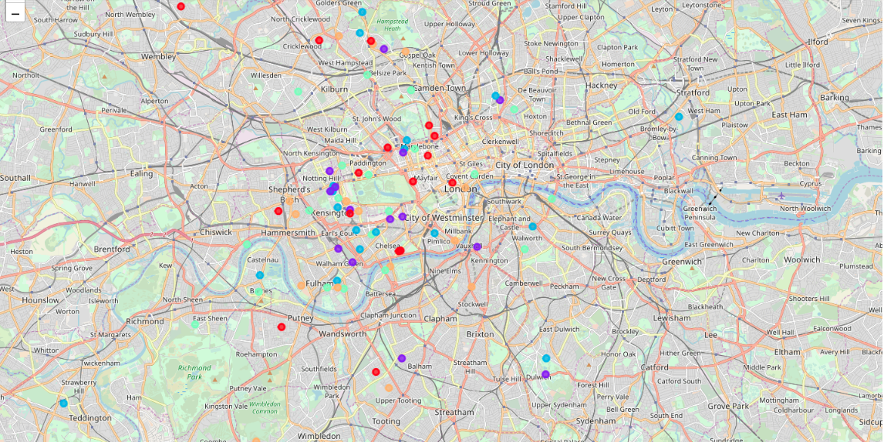
K-Means clustering of Properties

Slide 7

Outcome: 1
Examination of real estates by neighborhoods
West London (Notting Hill, Kensington, Chelsea, Marylebone) and North-West London (Hampsted) might be considered highly profitable venues to purchase a real estate;
South-West London (Wandsworth, Balham) and North-West London (Isliington) are arising as next future elite venues with a wide range of amenities and facilities.

Slide 8
Outcome: 2
Examination of real estates by clusters
Clusters 0, 2 and 4 may target home buyers prone to live in 'green' areas with parks, waterfronts;
Clusters 1 and 3 may target individuals who love pubs, theatres and soccer.

